Slide 1


King’s Digital Lab
Creating digital tools to explore academic research in new ways.
kdl.kcl.ac.uk
@kingsdigtallab

Slide 2
RESEARCH CASE Questions and prompts
What is the “elevator pitch” for the project? If the PI only had 30 seconds to communicate the idea, how would they do that?
What is it trying to achieve at its core? How will the research domain be enriched through this work?
How do digital methods support these aims? Is there a risk of over-engineering a technical solution to meet a simple need?
What are the tangible digital outputs planned for? How should audiences engage with the completed research? What will be the legacy of this project and how to we plan to protect it?
Notes:
In understanding the goals of a research project there are some obvious questions, but I might categorise these initial questions as project focused vs partner focused.
On one hand we clearly need to understand what the aspirations are at an academic level.

Slide 3
RESEARCH CASE Questions and prompts
What distinguishes this research as particularly ambitious or innovative?
Does the project align with current internal goals and strategies?
Does the project align with internal research interests?
Does the project offer an opportunity to engage with new technology and approaches?
Does the project offer an opportunity to develop a mutually beneficial strategic relationship with an interesting partner?
Does the project align with your institutional values and ethical considerations?
Have the RSE team had previous experience of working with this project team or members of the team?
Will the project team fully engage with the SDLC processes?
Notes:
On the other hand, there are questions which reflect our own agency and values in the research.

Slide 4
BACKGROUND CONTEXT Questions and prompts
- What previous work (if any) is being built upon? - Has previous work in this area failed to produce quality research? If so, why? - Is there an existing resource upon which this new work depends? - Does the RSE team have access to the necessary expertise to fulfil the project requirements? - How amenable to digitisation or to computational processing are the data sources being proposed? - Are there sample data to access and assess? - Where are the datasets hosted if they already exist or where is the project team expecting to host them, and for how long? - How amenable to archiving is the project being proposed? - Are the ambitions of the team realistic? - Does the project present ethical concerns?

Slide 5
SOLUTION ARCHITECTURE Questions and prompts
- Does the proposed technical solution take into account data standards? - Does it, or will it ultimately, adhere to FAIR principles? - Is it clear that the RSE team has sufficient expertise to implement the solution? - Is the solution scalable? Does it need to be? - Which RSE roles will be performing which tasks?
DEVELOPMENT APPROACH Questions and prompts
- Where will the evolving solution be hosted? - What backup strategies are in place? - Which channels and protocols should the research team use to seek or provide feedback? - How and when will review meetings take place? - When will change freeze be implemented?
Notes:
Only when we have enough information about the project and the partner, can we as a team start to think about the technical approach and the management approach.

Slide 6
What is our stakeholder trying to achieve?
What else would it be helpful to know?
What technical considerations can we infer?
What initial creative ideas does this prompt?
What sort of requirements (MoSCoW?) can we draw from this?

Slide 7
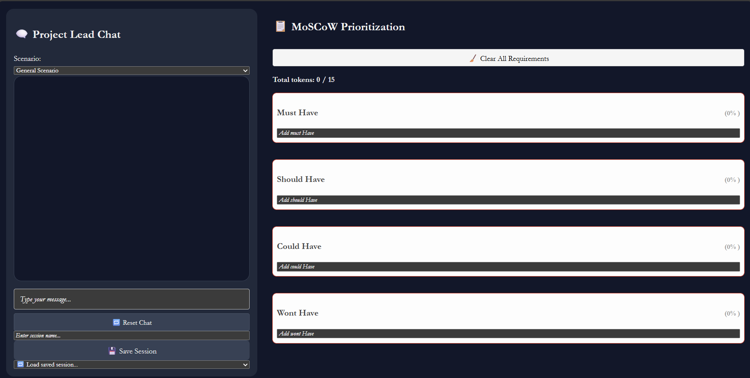
Notes:
Exercise here about questions to ask?
Group suggestions?

